Slide 1
Joins in SQL
SQL Day 4 class

Slide 2
Learning Objectives
By the end of this lesson, you will be able to:
By the end of this lesson, you will be empowered to:
Expertly Identify Joins: Recognize and comprehend various types of SQL joins.
Master Join Distinctions: Confidently differentiate between INNER and OUTER joins.
Apply Join Mastery: Skillfully utilize these concepts in your SQL queries.
Notes:
Speaker Notes:
"Welcome, everyone! Today's lesson is all about SQL joins, and by the end of our session, you'll have acquired some valuable skills."
"Our primary objectives are threefold. First, we'll delve into the world of joins and understand their various types."
"Next, we'll take a deep dive into INNER and OUTER joins, ensuring you can distinguish between them with ease."
"Finally, we'll put this knowledge to practical use, showing you how to apply these join concepts effectively in your SQL queries."

Slide 3
JOINs Combine Related Data
SQL Joins help combine data from different tables into a single result.
They find matching rows in tables based on shared columns, like IDs.
SQL Joins are crucial for working with multiple tables effectively.
They are used to build complex queries, reports, and data analysis.
Notes:
Welcome, everyone! Today, we're going to dive into the world of SQL Joins, a powerful concept that allows us to bring data together from different tables.
SQL Joins work by connecting related information in tables using common columns, often referred to as IDs or keys.
Understanding SQL Joins is fundamental in working efficiently with multiple tables in a database.
These joins are the building blocks for constructing intricate queries, generating meaningful reports, and conducting comprehensive data analysis.

Slide 4
JOINs Combine Related Data
The JOIN Statement in SQL:
SELECT columns: Choose which fields to include in the output.
FROM Table1: Specify the first table you're working with.
JOIN Table2: Indicate the second table you want to combine.
ON condition: Define the logic for matching rows between the tables.
Example:
SELECT *
FROM Table1
INNER JOIN Table2
ON Table1.id = Table2.table1_id;
Notes:
Speaker Notes:
Let's demystify the SQL JOIN statement and see it in action with an example.
The JOIN statement involves several components, as listed above.
To make it practical, we'll examine this SQL query example.
In this example, we're combining data from Table1 and Table2 using an INNER JOIN, where rows match based on the id and table1_id columns.

Slide 5
JOINs Combine Related Data
Before we delve into the world of SQL JOIN types, let's reflect on the practical application we've just witnessed.
By exploring this real-world example, we've seen how SQL JOINs can merge data intelligently from multiple tables.
Now, let's transition our focus to the main types of SQL JOINs and gain a deeper understanding of their distinct functionalities.
Notes:
As we progress through our discussion on SQL JOINs, it's important to take a moment to appreciate the practicality of what we've just seen in our example query.
This real-world example has illustrated how SQL JOINs intelligently combine data from various tables, giving us valuable insights into their power and potential.
Now, with this foundation in mind, let's pivot our attention to explore the main types of SQL JOINs and their unique characteristics.

Slide 6
JOINs Combine Related Data
INNER JOIN:
Purpose: Retrieves matching rows from both tables based on the join condition.
Effect: Excludes rows from either table that don't meet the specified criteria in the ON clause.
OUTER JOIN (or FULL OUTER JOIN):
Purpose: Retrieves all rows from both tables.
Effect: Displays unmatched rows from both tables, filling in NULL values for columns where no match is found.
Notes:
Speaker Notes:
Let's explore the main types of SQL JOINS, focusing on both INNER JOIN and OUTER JOIN.
INNER JOIN ensures that only matching rows from both tables are included in the result, excluding those that do not meet the specified criteria in the ON clause.
Conversely, OUTER JOIN (or FULL OUTER JOIN) combines all rows from both tables, including unmatched rows from both sides. In cases where no match is found, NULL values are used to fill in the gaps.

Slide 7
JOINs Combine Related Data
LEFT JOIN:
Purpose: Retrieves all rows from the left table and matching rows from the right table.
Effect: Right table columns are NULL if no match is found in the left table.
RIGHT JOIN:
Purpose: Retrieves all rows from the right table and matching rows from the left table.
Effect: Left table columns are NULL if no match is found in the right table.
Notes:
Speaker Notes:
Continuing our exploration of SQL JOIN types, let's now focus on both LEFT JOIN and RIGHT JOIN.
LEFT JOIN retrieves all rows from the left table, including matching rows from the right table. If there's no match in the right table, right table columns display NULL values.
Conversely, RIGHT JOIN retrieves all rows from the right table, including matching rows from the left table. If there's no match in the left table, left table columns display NULL values.

Slide 8
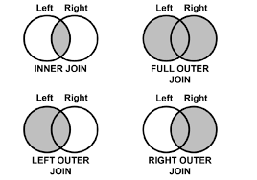
JOINs Combine Related Data
Notes:
In this visual representation, we can clearly see the four primary SQL JOIN types we've discussed: INNER JOIN, LEFT JOIN, RIGHT JOIN, and OUTER JOIN.
Each type has its unique characteristics and purpose in combining data from multiple tables.
The INNER JOIN brings together matching rows, while the LEFT JOIN retrieves all rows from the left table and matches from the right table.
Conversely, the RIGHT JOIN retrieves all rows from the right table and matches from the left table.
Finally, the OUTER JOIN, also known as FULL OUTER JOIN, combines all rows from both tables and fills in NULL values when there's no match.
Visualizing these JOIN types can help you better understand how they work and choose the right one for your specific data retrieval needs.

Slide 9
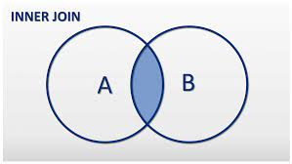
Inner Join Fundamentals
Notes:
Speaker Notes:
In this visual representation, we have an example of an INNER JOIN in action.
The diagram illustrates how an INNER JOIN combines data from two tables, including only the rows that have matching values based on the specified join condition.
As you can see, the result set contains only the overlapping area where the data from both tables aligns according to the join condition.
This graphical representation provides a clear visualization of how an INNER JOIN functions to retrieve matching data from multiple tables.

Slide 10
Inner Join Fundamentals
Inner Join Concepts
Ideal for assembling connected data.
Result only includes related data.
No duplication or missing values.
Great for combining data about the same entities.
INNER JOIN Example:
SELECT *
FROM TableA
JOIN TableB
ON TableA.id = TableB.tablea_id;
Notes:
Speaker Notes:
Now, let's dive deeper into the concept of INNER JOIN and its key characteristics.
An INNER JOIN is ideal when you need to assemble connected data from multiple tables. It ensures that the result set includes only the data that has corresponding matches in both tables based on the defined join condition.
One of the strengths of INNER JOIN is that it avoids duplication or missing values in the result, providing a clean and complete dataset.
This type of join is particularly effective when you're combining data related to the same entities from different tables, creating a unified view.
The example query demonstrates how an INNER JOIN is structured in SQL. In this case, we're joining TableA and TableB based on the common column "id" in TableA and "tablea_id" in TableB.

Slide 11
Inner Join Fundamentals
The key differences between JOIN and INNER JOIN:
JOIN by itself implicitly means INNER JOIN
They function the same way - matching rows where the ON condition is true
JOIN and INNER JOIN produce the same result set joining on a condition.
The INNER JOIN syntax just makes it clearer that you are intending an inner join rather than a different join type.
Notes:
Speaker Notes:
Let's delve into a common source of confusion: the difference between JOIN and INNER JOIN in SQL.
When you use JOIN alone, it's essentially shorthand for INNER JOIN. They share the same functionality, aligning rows based on the specified ON condition.
Whether you opt for JOIN or explicitly use INNER JOIN, the outcome is identical—a result set formed by joining tables according to the specified condition.
The distinction lies in clarity. The INNER JOIN syntax explicitly communicates your intent for an inner join, ensuring your SQL queries are easily understood.

Slide 12
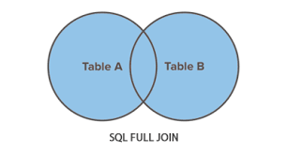
Full Outer Join Fundamentals
Notes:
Speaker Notes:
In this visual representation, we have an example of an OUTER JOIN.
The diagram illustrates how an OUTER JOIN combines data from two tables, including all rows from both tables, while still considering the specified join condition.
As you can see, the result set contains all records from both tables, with matching records based on the join condition and NULL values for columns where there is no match.
This graphical representation provides a clear visualization of how an OUTER JOIN works to retrieve data comprehensively from both tables, ensuring no data is left behind.

Slide 13
Full Outer Join Fundamentals
FULL OUTER JOINs Complete Data
Matching and Unmatched Rows from Both Tables
Returns all rows from the left and right tables
If no match, columns are NULL for missing side
FULL OUTER JOIN Example:
SELECT *
FROM TableA
FULL JOIN TableB
ON TableA.id = TableB.a_id;
Notes:
Speaker Notes:
Now, let's explore the power of a FULL OUTER JOIN, which completes the data puzzle by including matching and unmatched rows from both tables.
In a FULL OUTER JOIN, you get the best of both worlds—it returns all rows from both the left and right tables, ensuring no data is left behind.
When there's no match between rows, the columns for the missing side are filled with NULL values, maintaining the structure of the result set.
The example query illustrates how a FULL OUTER JOIN is written in SQL. In this case, we're joining TableA and TableB based on the common column "id" in TableA and "a_id" in TableB.

Slide 14
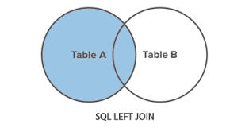
Left Join Fundamentals
Notes:
Speaker Notes:
In this visual representation, we have an example of a LEFT JOIN.
The diagram illustrates how a LEFT JOIN combines data from two tables, including all rows from the left table and matching rows from the right table based on the specified join condition.
As you can see, the result set contains all records from the left table, and matching records from the right table, if any. Rows from the left table with no match in the right table will still appear in the result with NULL values for right table columns.
This graphical representation provides a clear visualization of how a LEFT JOIN functions to retrieve data from both tables while preserving all records from the left side.

Slide 15
Left Join Fundamentals
Leveraging LEFT JOIN
Ideal for assembling connected data.
Includes all records from the left table and related data from the right table.
NULL values appear for unmatched right table records.
Useful for preserving data from the left table.
LEFT JOIN Example:
SELECT *
FROM TableA
LEFT JOIN TableB
ON TableA.id = TableB.tablea_id;
Notes:
Speaker Notes:
Building on our understanding of joins, let's explore the LEFT JOIN and its unique characteristics.
A LEFT JOIN is your choice when you want to assemble connected data while preserving all records from the left table.
Key features:
It includes all records from the left table and adds related data from the right table based on the join condition.
When there's no match on the right side, NULL values appear in the result set for unmatched records.
This type of join is incredibly useful for preserving data from the left table, even when there are no corresponding matches on the right side.
The example query demonstrates a LEFT JOIN between TableA and TableB, using "id" from TableA and "tablea_id" from TableB as the join condition.

Slide 16
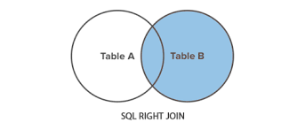
Right Join Fundamentals
Notes:
Speaker Notes:
In this visual representation, we have an example of a RIGHT JOIN.
The diagram illustrates how a RIGHT JOIN combines data from two tables, including all rows from the right table and matching rows from the left table based on the specified join condition.
As you can see, the result set contains all records from the right table, and matching records from the left table, if any. Rows from the right table with no match in the left table will still appear in the result with NULL values for left table columns.
This graphical representation provides a clear visualization of how a RIGHT JOIN functions to retrieve data from both tables while preserving all records from the right side.

Slide 17
Right Join Fundamentals
Harnessing the Power of RIGHT JOIN
Ideal for connecting data while preserving all records from the right table.
Includes all records from the right table and related data from the left table.
NULL values appear for unmatched left table records.
Valuable for maintaining data from the right table.
RIGHT JOIN Example:
SELECT *
FROM TableA
RIGHT JOIN TableB
ON TableA.id = TableB.tablea_id;
Notes:
Speaker Notes:
Much like the LEFT JOIN, the RIGHT JOIN is a formidable tool for connecting data, but with a twist.
It's the ideal choice when you want to establish data connections while ensuring that all records from the right table are included.
Key characteristics:
It includes all records from the right table and adds related data from the left table based on the join condition.
When there's no match on the left side, NULL values appear in the result set for unmatched records.
RIGHT JOIN is particularly valuable for maintaining data from the right table, even when there are no corresponding matches on the left side.
The example query showcases a RIGHT JOIN between TableA and TableB, using "id" from TableA and "tablea_id" from TableB as the join condition.

Slide 18
Right Join Fundamentals
LEFT JOIN vs. RIGHT JOIN: When to Choose Right
LEFT JOIN is used 95% of the time.
Reasons to use RIGHT JOIN:
Sometimes you can be too lazy to reorder an ad hoc query.
Confuse other people.
Inherit existing code from others.
Notes:
Speaker Notes:
In the world of SQL JOINs, LEFT JOIN is the go-to choice, accounting for approximately 95% of JOINs used in practice.
However, there are scenarios where opting for a RIGHT JOIN might be appropriate. Let's explore when to consider it:
Ad Hoc Queries: Sometimes, when working with ad hoc queries, you might find it more convenient to use a RIGHT JOIN to avoid reordering your data.
Confusing Others: In some cases, intentionally using a RIGHT JOIN might be a way to emphasize specific data or relationships, even if it's unconventional and could potentially confuse others.
Inheriting Code: When inheriting code from others or working within an existing codebase that predominantly uses RIGHT JOINs, maintaining consistency might lead you to continue using them.

Slide 19
Why Use Join Alias
Join aliases are useful for assigning table aliases in JOIN statements.
Improves readability.
Simplifies coding.
Requires typing shorter aliases.
Allows identical column names across tables.
SQL JOIN with Aliases Syntax:
SELECT column_list
FROM table1 alias1
JOIN table2 alias2
ON alias1.join_column = alias2.join_column
Notes:
Speaker Notes:
Table aliases in SQL JOINs are a handy tool that can significantly enhance your query-writing experience.
By assigning aliases to tables involved in JOINs, you can improve the readability of your SQL code and simplify the process of writing complex queries.
The use of shorter aliases reduces typing effort and helps avoid naming conflicts, particularly when tables have columns with the same name.
The syntax for a SQL JOIN with aliases is straightforward, as shown here. It allows you to specify column lists and join conditions with clarity and brevity.

Slide 20
Why Use Join Alias
Without Aliases:
SELECT customers.name, orders.amount
FROM customers
JOIN orders
ON customers.id = orders.customer_id;
With Aliases:
SELECT cust.name, ord.amount
FROM customers cust
JOIN orders ord
ON cust.id = ord.customer_id;
Notes:
Speaker Notes:
Let's see how table aliases can significantly simplify your SQL queries. Take a look at these two examples.
In the first query, without aliases, you'll notice that we have to use the full table names every time we reference columns from customers and orders. It can make the code lengthy and less readable.
Now, contrast that with the second query, which uses table aliases. By assigning short aliases (in this case, "cust" for customers and "ord" for orders), we can simplify the query and improve readability. The JOIN conditions remain clear and concise.
Table aliases are a practical technique that not only reduces typing effort but also makes your SQL code more elegant and comprehensible.

Slide 21
Join Conditions Related to Table Data
Now that we've explored different types of SQL JOINS, let's shift our focus to the critical element that glues them together: JOIN conditions.
Notes:
As we continue our journey into the world of SQL JOINS, it's time to delve deeper into the glue that holds these joins together: JOIN conditions.
We've seen how different types of joins can bring data together, but the magic happens when we define the criteria for matching rows using JOIN conditions.
So, let's transition our discussion to understand the importance and mechanics of these crucial conditions.

Slide 22
Join Conditions Related to Table Data
The ON clause specifies how two tables are related.
It matches rows between tables based on column values.
This connects related data across tables.
Key Things to Know:
Essential component of table joining.
Basis for linking and analyzing related table data.
Filters query results based on defined relationships.
Typically compare key columns like ID fields.
Notes:
Speaker Notes:
Now, let's delve into the essential concept of defining table relationships through the ON clause.
The ON clause is where we specify how two tables are related, matching rows based on column values. This connection is what allows us to bring together related data from different tables.
Some key things to remember:
It's an essential component of table joining, determining how tables are linked.
It forms the basis for linking and analyzing data from related tables.
JOIN conditions defined in the ON clause filter query results based on these relationships.
Typically, key columns like ID fields are compared to establish these connections.

Slide 23
Join Conditions Related to Table Data
Typical Join Condition:
ON Customers.CustomerID = Orders.CustomerID
Relating Table Data via Keys:
Common for standardized relationships.
Links core table entities like customers to transactions.
Why Match on Keys?
Simplifies data relationships.
Ensures data integrity.
Enhances query performance.
Notes:
Speaker Notes:
In SQL JOINs, we often use join conditions like the one shown here, where we connect tables based on specific columns, such as CustomerID in Customers and Orders.
Matching tables via keys, as seen in the second point, is a common practice, especially in standardized relationships. It enables us to link fundamental entities, like customers to their transactions.
But why do we match on keys? It simplifies data relationships, ensures data integrity, and enhances query performance, making it a crucial practice in database management.

Slide 24
Join Conditions Related to Table Data
Keys in Databases:
Keys uniquely identify records within a table.
Primary keys are essential for record uniqueness.
Foreign keys establish relationships between tables.
Entity-Relationship Diagrams (ERD):
Visual representation of a database's structure.
Depicts tables, keys, and relationships.
Crucial tool for database design and understanding.
Notes:
Speaker Notes:
Keys play a pivotal role in databases. They are unique identifiers that distinguish records within a table. Primary keys ensure record uniqueness within a table, while foreign keys establish connections between tables, forming the basis of relationships.
When we zoom out to view the bigger picture, we have Entity-Relationship Diagrams, often referred to as ERDs. These diagrams provide a visual representation of a database's structure. They showcase tables, their keys, and the relationships between them. ERDs are crucial tools for both database design and understanding the complex web of connections within a database.

Slide 25
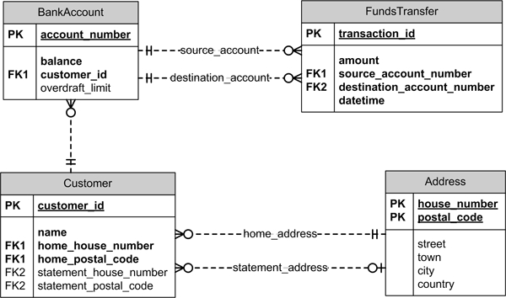
Join Conditions Related to Table Data
Notes:
Speaker Notes:
Now that we've discussed the importance of keys in databases and their role in establishing relationships, let's take a visual journey into the world of Entity-Relationship Diagrams (ERDs).
In this ERD, you'll see tables represented as entities, each with its unique set of attributes. These tables are connected by lines, symbolizing the relationships between them.
ERDs serve as an essential bridge between keys and the overall database structure. They visually illustrate how keys, both primary and foreign, play a pivotal role in connecting and organizing data within a database.
As we explore this ERD, pay close attention to how keys act as the glue that links tables and enables the efficient retrieval of interconnected data.

Slide 26
Joins Enabled Aggregated Analysis
Blending Joins and Aggregates
Joining multiple tables FIRST in a SQL query, and then aggregating the resulted joined data using functions like SUM, COUNT, AVG, etc.
For example:
Join a customers table to an orders table
Then, aggregate the joined data to summarize rather than seeing individual rows
This allows you to lend row level and summary data together

Slide 27
Joins Enabled Aggregated Analysis
SQL Syntax Pattern
SELECT customers.name, SUM(orders.amount) AS total_purchased
FROM customers
INNER JOIN orders
ON customers.id = orders.customer_id
GROUP BY customers.name

Slide 28
Joins Enabled Aggregated Analysis
Join a customers table to an orders table
SELECT c.name, o.amount
FROM customers c
JOIN orders o
ON c.id = o.customer_id
Then, aggregate the joined data
SELECT c.name, SUM(o.amount)
FROM customers c
JOIN orders o
ON c.id = o.customer_id
GROUP BY c.name

Slide 29
Joins Enabled Aggregated Analysis
Examples Using AdventerWorks2012:
Average reseller sales amount per year:
SELECT YEAR(sh.OrderDate) AS OrderYear, AVG(sd.LineTotal) AS AverageSales
FROM Sales.SalesOrderHeader sh
INNER JOIN Sales.SalesOrderDetail sd
ON sh.SalesOrderID = sd.SalesOrderID
GROUP BY YEAR(sh.OrderDate)

Slide 30
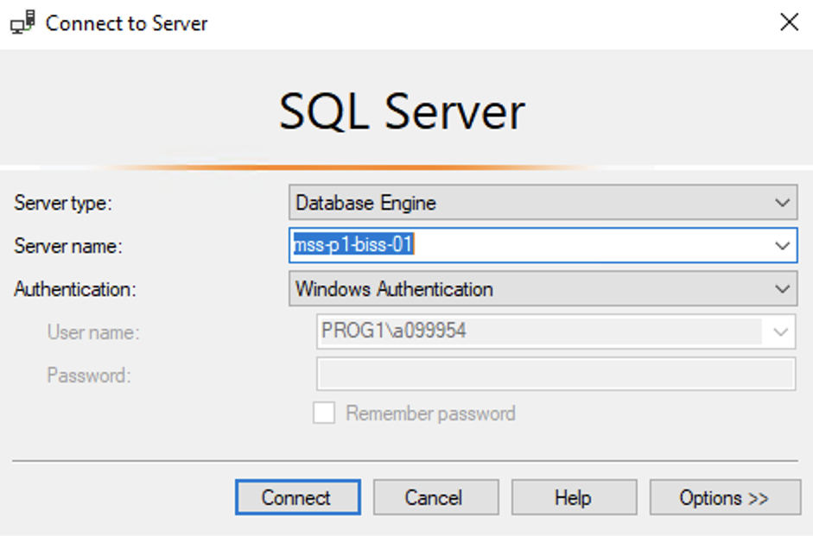
Hands On Examples
Using the AdventureWorks2012 Database
Please open up SSMS
Connect to BISS
Server = mss-p1-biss-01

Slide 31
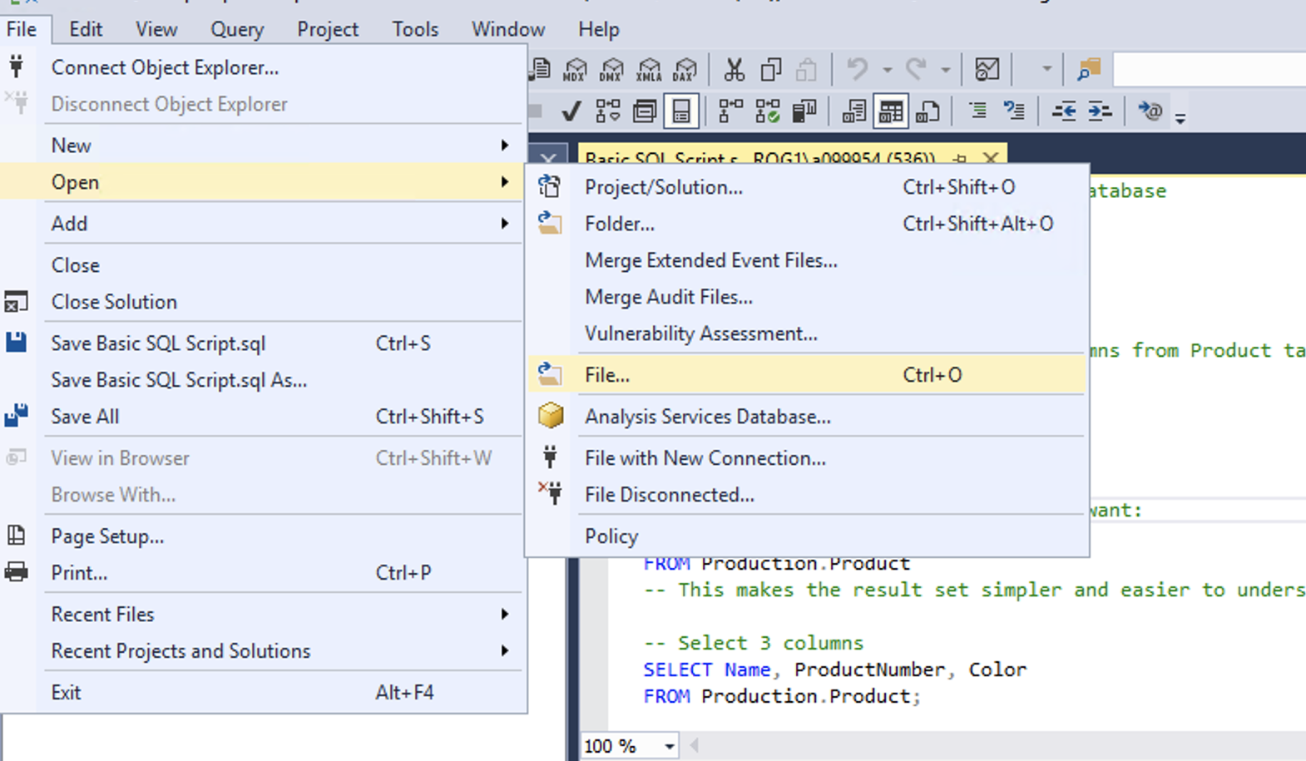
Hands On Examples
Click File -> Open -> File

Slide 32
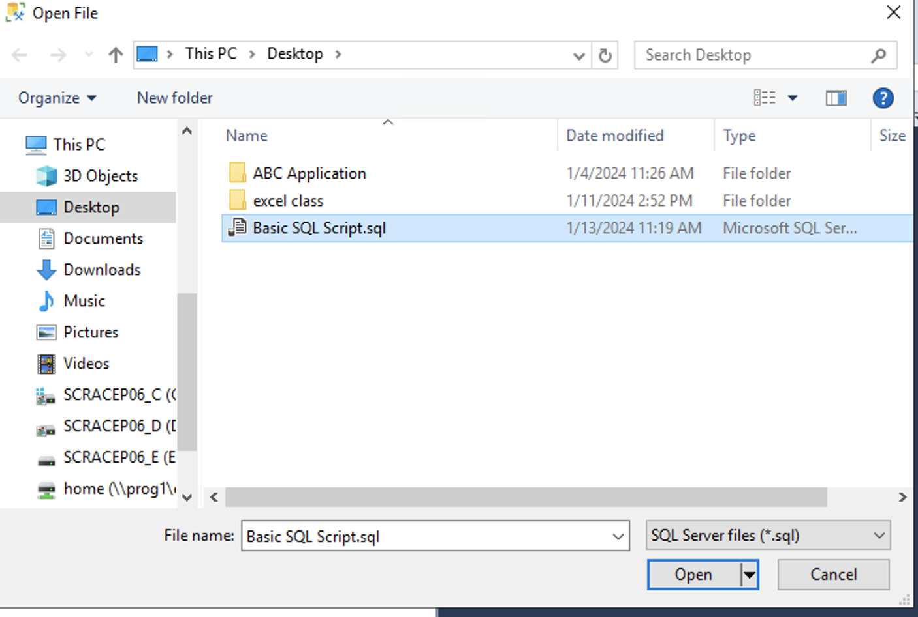
Hands On Examples
Open the SQL Day 4 Joins Script.sql file
Notes:
Walk through each function

Slide 33
Summary
Best Practices:
Use aliases for easier coding
Use LEFT JOIN every time
Aggregate and filter joined data
Optimize join order and performance
Purpose:
Joins deliver a foundation for many analytical tasks by interrelating data distributed across tables.
Careful construction and validation enables deriving maximum value

Slide 34
Exercise
Open the Day 4 Exercise.sql file
Answer the questions from each section
Notes:
Answers are stored in the Exercise Answers.sql file

